Slide 1
Research Support Program (RSP)
Proposal Review, Selection Process, Review Criteria
Notes:
You will find the proposal review and selection process information on this tab on the RSP main webpage.

Slide 2
Access the RSP Webpage:
Research Support Program (auburn.edu)

Slide 3
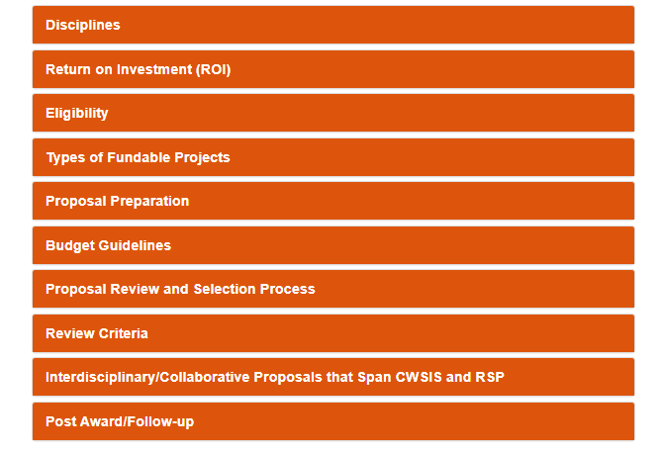
Proposal Review and Selection Process

Slide 4
Proposal Review and Selection Process
Two-Tiered Review and Selection Mechanism
First Step – ADR committee review
ADR and his/her committee will review each application in their department
Only five (5) applications from each college/school will be forwarded to the external reviewers
Second Step – External review
Cognizant external reviewers will assess the down selected applications
Notes:
There will be a two-tiered review and selection mechanism for this program.

Slide 5
Review Criteria
Notes:
The specific review criteria is listed in detail under this tab on the webpage.

Slide 6
RSP Review Criteria
The Research Support Program (RSP) is intended to be an annual cycle funding program to foster the development and growth of innovative and transformative research activities.
The RSP is a strategically focused Auburn University investment strategy that promotes promising and impactful new lines of research as well as the growth of collaborative and/or interdisciplinary teams that are built upon the foundations of science.
Research activities supported by the RSP will have a strong potential to attract extramural funding for sustained research efforts.
Investing in the RSP supports the University’s strategic plan by elevating research and scholarly impact to address society’s critical issues and promote economic development in Alabama and beyond.
Notes:
Each reviewer is reminded to keep the specific RSP review criteria in mind while they are reviewing applications.

Slide 7
Evaluation Worksheets
Internal and external reviewers will utilize the same worksheet
Combination of ratings and comments
Scoring system for ratings
1 is lowest/5 is highest
Notes:
All internal and external reviewers will utilize the same evaluation worksheets.

Slide 8
Ratings Section
Project Focus/Support and Rationale
Methodology/Approach
Expected Benefits and Implementation/Deliverables
Feasibility
Scoring system: 1 is lowest/5 is highest score
Notes:
There are a number of considerations for each of the following ratings questions. I will share of few of these with you; keep in mind that they are listed in detail on the webpage.
1- Project Focus/Support and Rationale: Are the goals, hypotheses or problem clearly articulated? Does the proposed project logically lead to future expanded projects supported by external funding opportunities? Is it clear and specific who could benefit and what the impact will be if the project is successful?
2- Methodology/Approach: Does the project effectively apply its stated methods/approach? What need is the contribution going to address? Is the proposed solution relevant to or applicable in real-world situations?
3- Expected Benefits and Implementation/Deliverables: Does the proposal demonstrate evident value? Does the project enhance the PI’s ability to obtain external funding? Does the project enhance the PI’s ability to elevate institutional image?
4- Feasibility: Is the budget realistic and commensurate with both the project needs and time frame? Are the project team members clearly identified, along with work experience, in the proposal? Does the team possess the skills uniquely qualifying them to complete the proposed scope of work?

Slide 9
Comments Section
Overall Impressions
Positive Aspects
Concerns
Items that Must be Addressed
Additional Reviewer Comments
Recommend for Funding: Yes/No

