Slide 1
Departmental Administration
– And The Top (Ten) Things Are…
From
Estelle Lang
Grants and Contracts Coordinator
School of Engineering
Brown University
Providence, RI
Randi Wasik, MBA
Director of Administration and Finance,
University of Washington
Seattle, Washington
With permission

Slide 2
What can we learn from each other?
How to manage time in our daily work day
Best practices we can all share and use
How to implement and accept change with:
Team work
Training
Useful motivation
Delegation
Autonomy
Useful tools

Slide 3
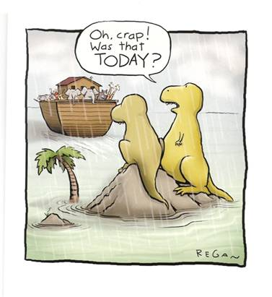
How Often Do You Say This?

Slide 4
Top Ten Research Administration Items Possibly on Your To Do List:
Pre – Award
Post - Award
Funding Announcement
Prepare Budget
Change Budget
Internal Deadline
Motivate Faculty
Procurement Card
Purchase Order
Travel Report
Reconcile
Analysis
Notes:
Here are just a sample of tasks what your day could consist of.

Slide 5
Top Ten Things Every Department Administrator Should Understand:
Organizational Knowledge
Job/Task Knowledge
Policies/Procedures
Insider Knowledge
Training Programs
Volunteer/Professional Opportunities
Work Flow
A-21, A-110, A-133/ Uniform Guidance
Cost Sharing/Effort Reporting/SubAwards
Document/Tracking/
Procedures
Allowable – Allocable - Reasonable
Sponsor Guidelines
Notes:
What are they?
How does the work happen?
Find out who controls what applications in your organization
Don’t try and memorize anything – the google gods are always helpful
Get as much information at the start of the process not at the end
Always remember to ask these questions

Slide 6
Top Ten Things Department Administrator Can Do:
For Team/With Team
Professional Development
Build Team/Grow with Team
Be/Stay Flexible and Organized
Set Realistic Goals
Find Training both Professional and Tool Training
Share: Knowledge/Visions - Communicate
COMPASS/ Mentor/Mentee Program
Workshops/Conferences
Communicate, Communicate, Communicate
Motivate, Motivate, Motivate
NCURA Regional and National Involvement

Slide 7
Manage The To Do List:
Pre Award To Do List:
Plan your deadlines
Talk with faculty and other researchers – go face to face
Create a checklist that works for you
Use/create a spreadsheet template for budgets that works for your department/organization
Set up reminders for faculty that are easy for them to see
Always remember to find a way to keep your sanity
Notes:
Deadlines: Do a little research and find out what kind of submissions your faculy/department have previously submitted and will be submitting to. List of websites – NCURA eRA Neighborhood site.
Checklists, Templates, Reminders: Show templates and ideas.

Slide 8
Manage The To Do List:
Post Award To Do List:
Organize, Organize, Organize….
ALWAYS ask: Is it…
Allowable?
Allocable?
Reasonable? - always keep in the back of your mind; this is tax payers dollars
Use the tools you’re given and ask for tools you’re not
Build relationships with everyone and understand what their role is – Supportive? Road block?

Slide 9
Helpful Knowledge
Organizational Information:
Be aware of your department and organizations policies and procedures – or at least where to find them
How things happen – where they come from or go to
Make notes about obscure information about your organization – you never know when you will need it
Find out about training that is or is not offered – HR trainings can be very useful when dealing with different personalities
Does your department or organization offer opportunities to volunteer or allow outside professional development opportunities

Slide 10
Helpful Knowledge
Job/Task Information:
OMB Circulars – what are they? Do I need to memorize them? When can they help? Uniform Guidance understanding?
Always find and read or scan sponsor announcement
Cost Sharing – Effort Reporting – SubAwards ………
Documentation – Tracking – Procedures…….
ALWAYS – Ask:
Is it Allowable?
Is it Allocable?
Is it Reasonable?

Slide 11
Helpful Knowledge
Team – Part of one and Leading one:
Get/Give Training
Lead by example
Reach out – don’t be an island
Communicate, Communicate, Communicate….
Motivate, Motivate, Motivate….

