Slide 1
Contracts & Grants Accounting’s “TOP 5” Series
“Documenting Expenditures”

Slide 2
Costs Normally Considered Unallowable
General Office Supplies
Computing Devices and Peripherals
Postage/Express Mail
Local phone service and cell phones
Photocopies
Books and Subscriptions
Internet and cloud services
Food and drinks
Personal protection (bug spray, sunscreen)
Batteries
“What in the world is this for?”

Slide 3
Recommendation #1
Write short justifications directly on receipt or in an attached memo.

Slide 4
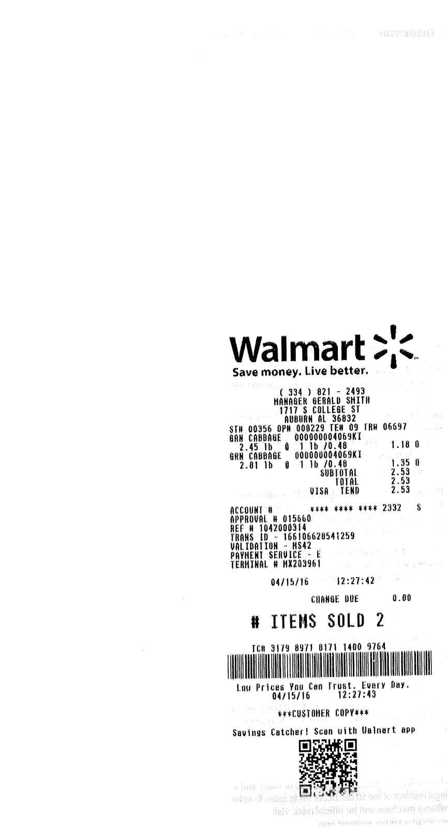

Slide 5
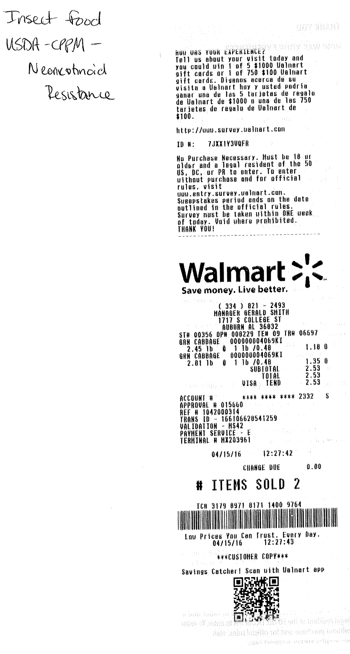

Slide 6
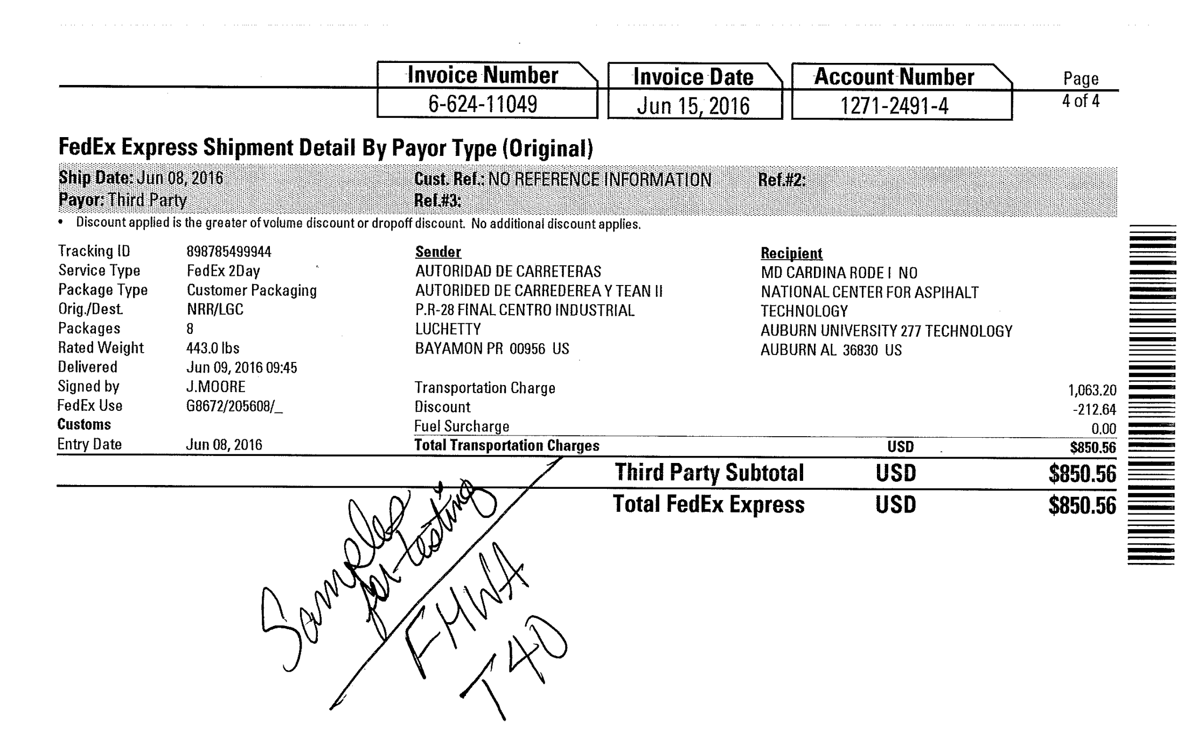

Slide 7
Recommendation #2
Make sure the receipt itself clearly indicates what was purchased, and if not, clarify on the receipt or in an attached memo.

Slide 8
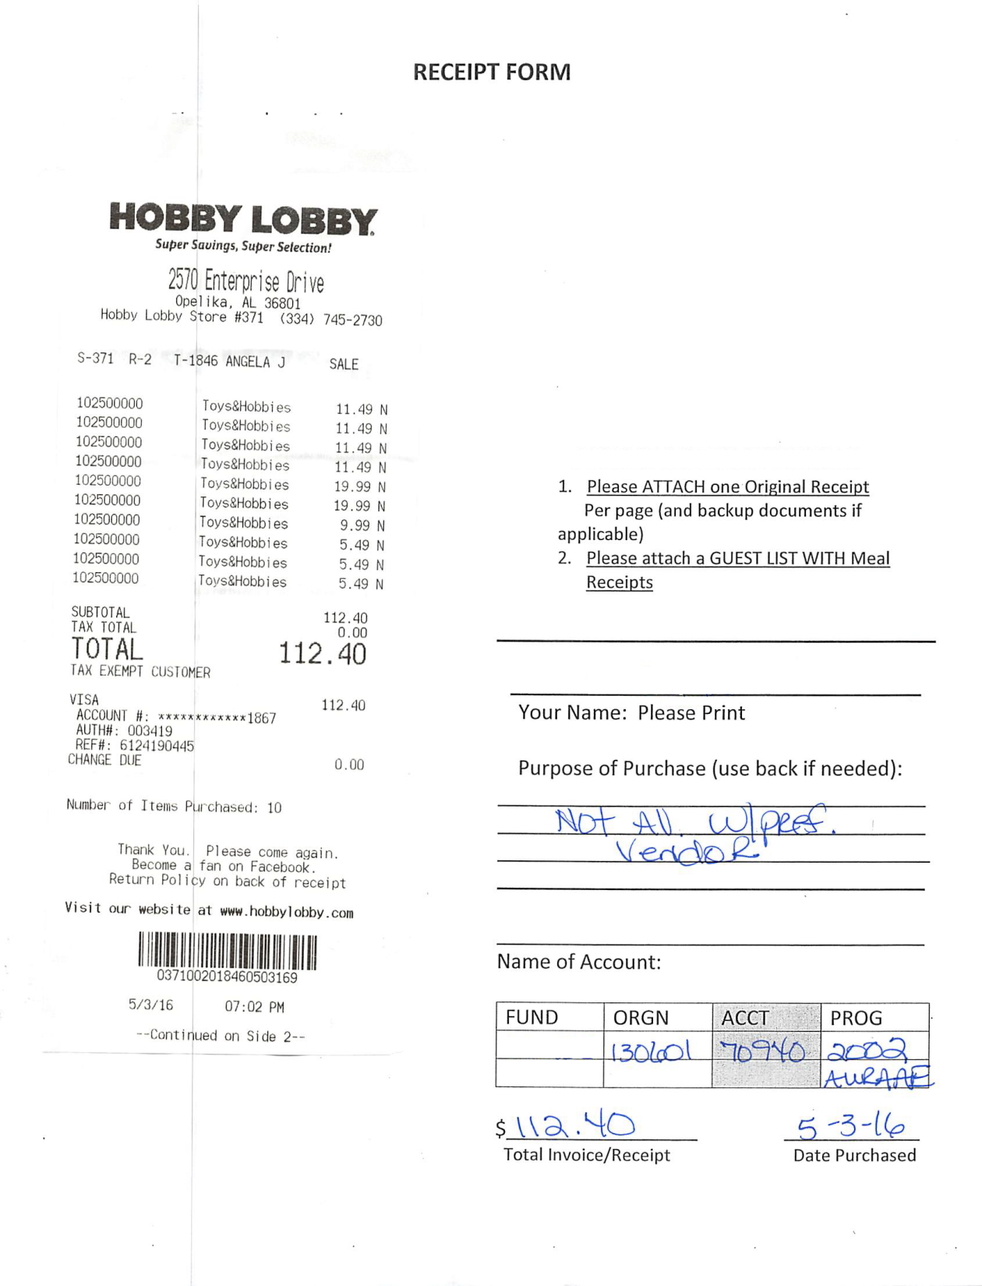

Slide 9
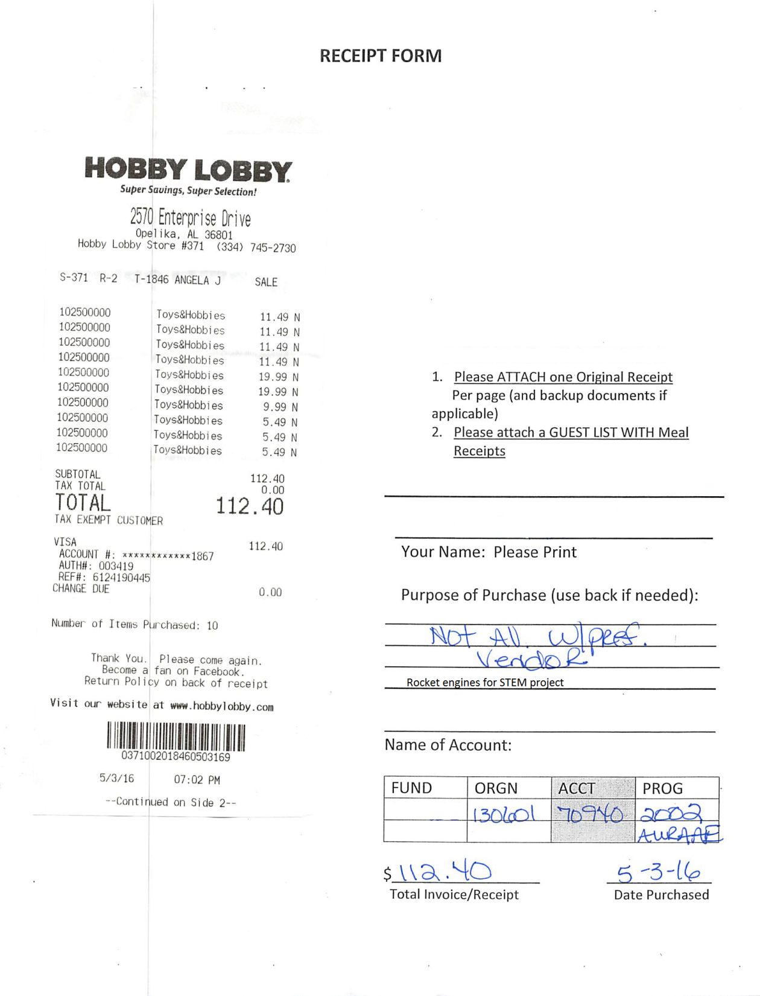

Slide 10
Recommendation #3
If a charge is split between two or more FOPs, document justification for amounts.
Shouldn’t be arbitrary
Shouldn’t be split simply to use up funds
Should be reasonable, logical and consistent

Slide 11
Case Study:
A PI has two awards to provide camps for kids from Birmingham City Schools and Montgomery City Schools.
The number of kids attending from each school system varies each week.
The PI hands you a pizza receipt and asks you to charge each grant half the cost.
What questions do you ask? How would you suggest that the cost be allocated? What documentation do you need to support your allocation between the two grants? What if the PI objects?

Slide 12
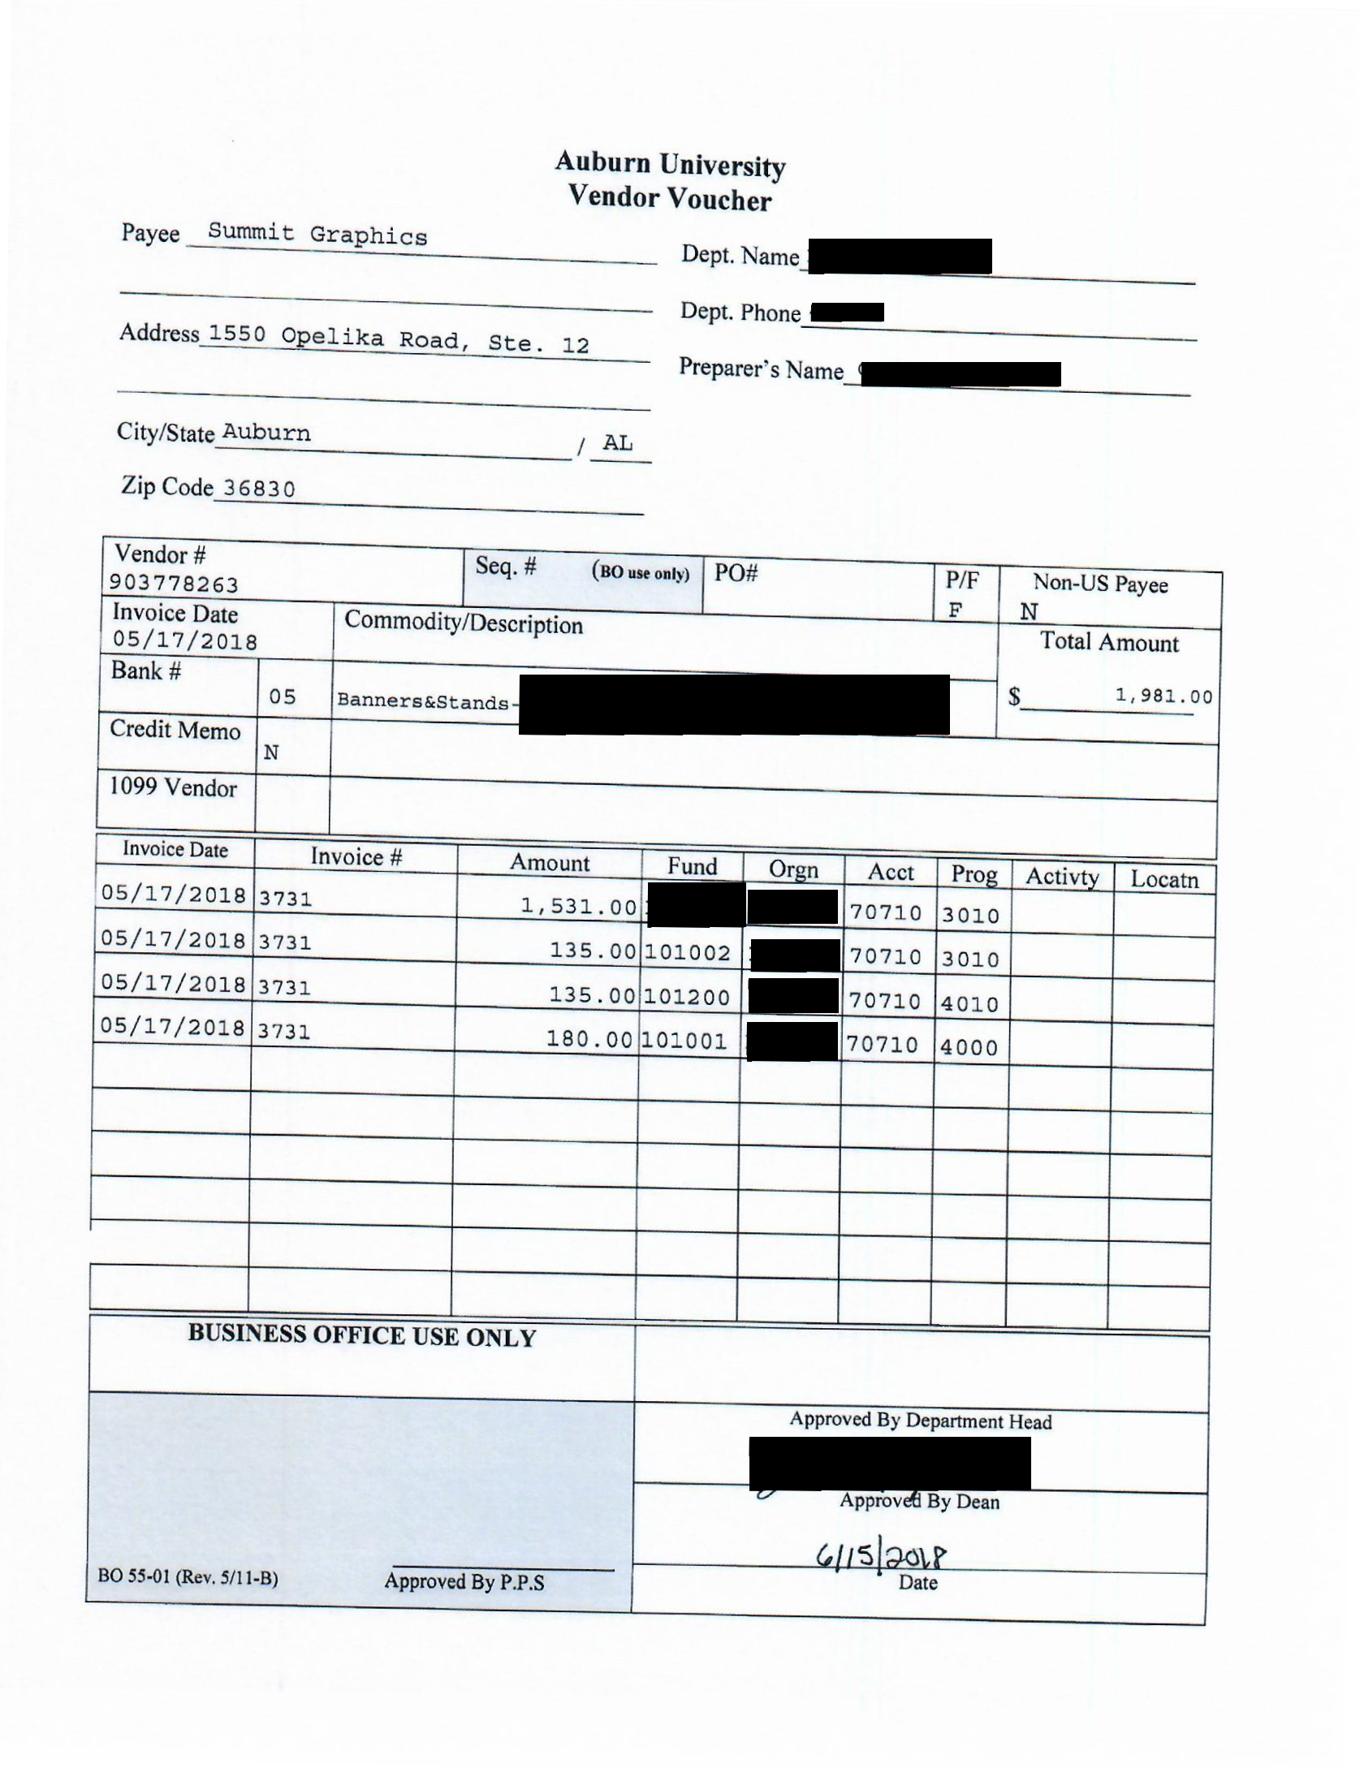

Slide 13
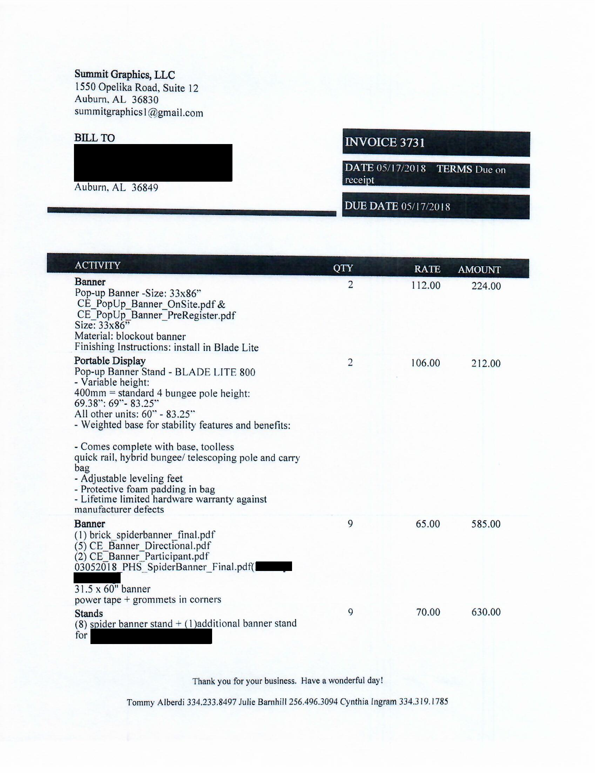

Slide 14
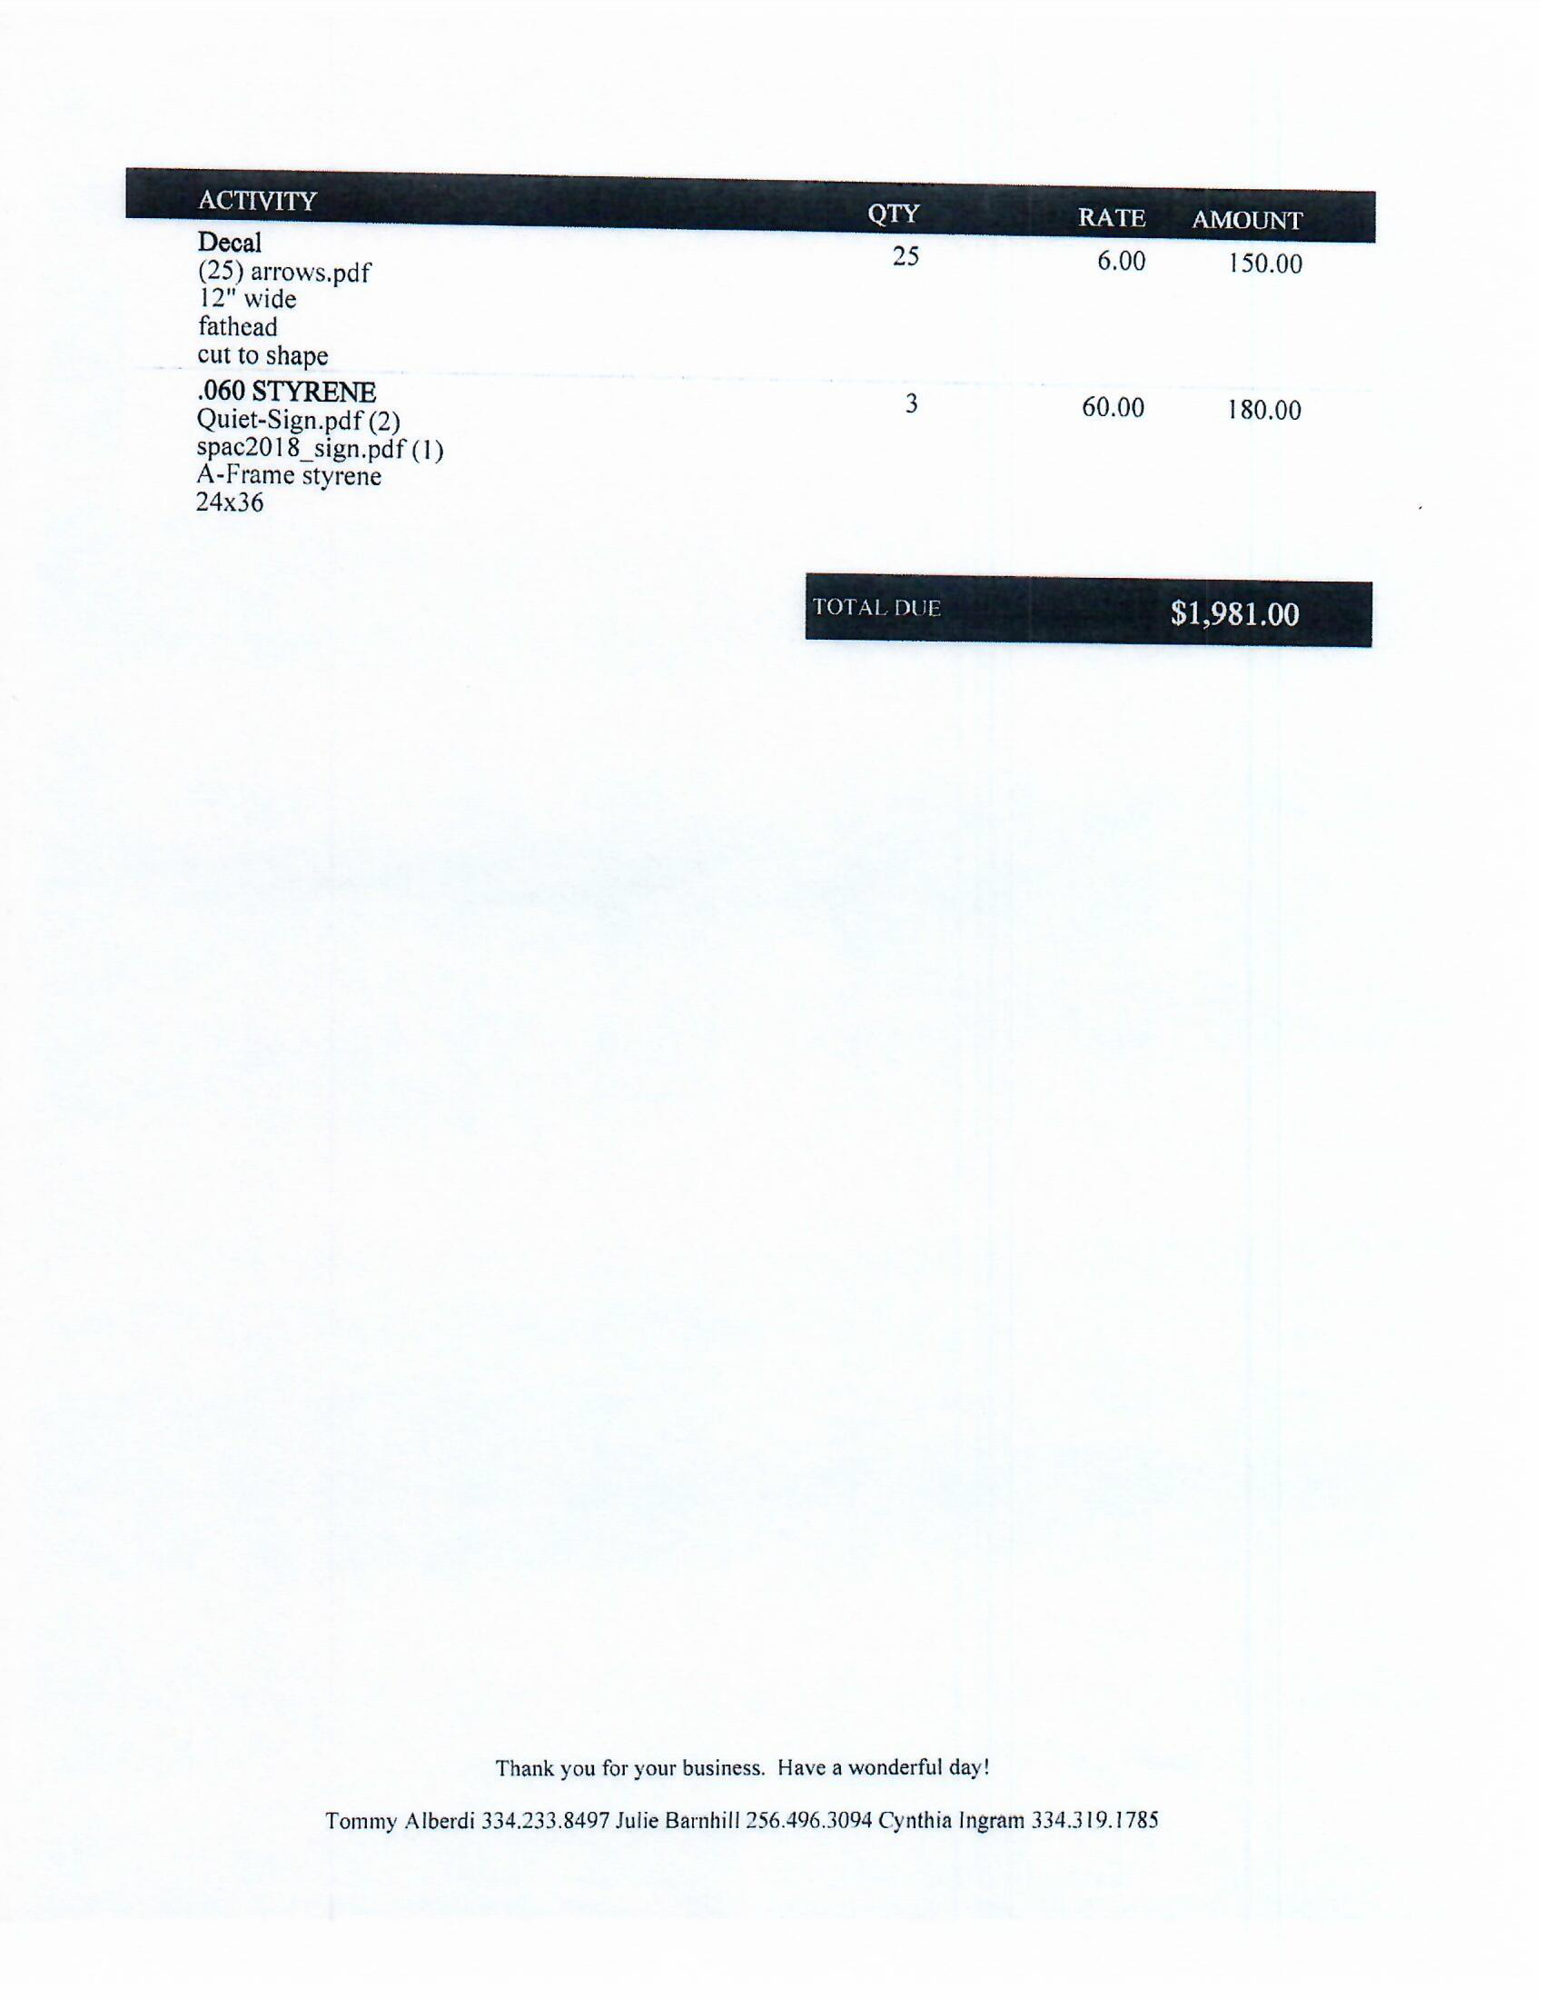

Slide 15
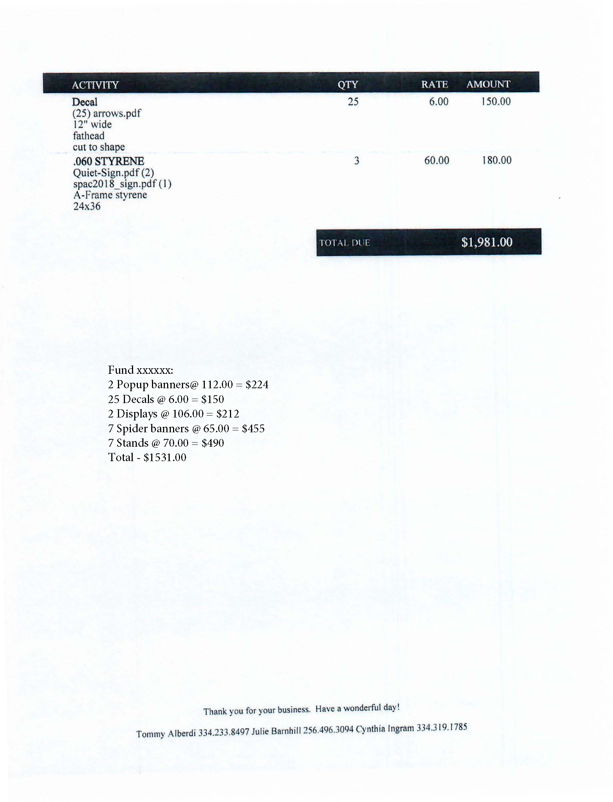

Slide 16
Recommendation #4
Think twice before charging.

Slide 17
Make sure FOP is correct and charges are appropriate
Measure twice, cut once
Two sets of eyes, especially with p-card recons
Has the fund expired?
Project End Date = last day to incur new charges
Expenditure End Date = Final Due Date

Slide 18
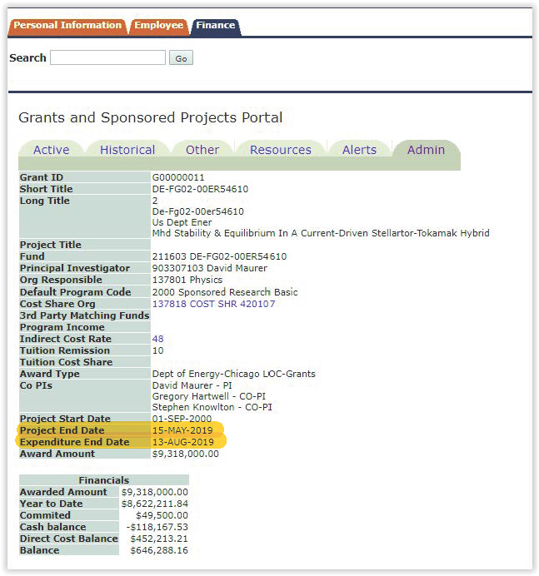

Slide 19
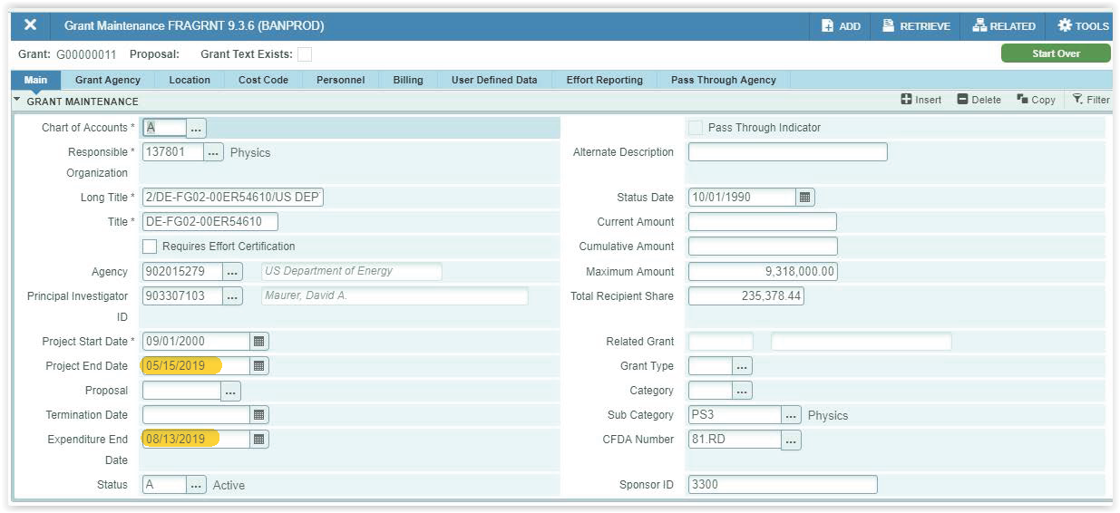

Slide 20
Recommendation #5
Train your PIs and staff.

Slide 21
Think like an auditor.
If you can’t make heads or tails out of a receipt and what it’s for, then CGA and auditors won’t be able to, either.
Smell test; newspaper test
Document to clarify purchase description and need.
Be proactive.
If in doubt, ask!
Be aware of when contract and grant awards expire.

Slide 22
Trust your training!

