Slide 1
RESEARCH INTEGRITY PRESENTATION
Conflict of Interest & Responsible Conduct of Research
COMPASS
February 17, 2021
Milly Tye (milly@auburn.edu) 334-844-8601

Slide 2
Conflict of Interest
What is it?

Slide 3
Conflict of Interest
Definitions
“Conflict of Interest or “COI” occurs when an employee or immediate family member has a personal interest in or receives a personal financial, economic, professional or personal gain or advantage of any kind from the employee's position in a manner that may inappropriately influence the employee's judgment, compromise the employee's ability to carry out Auburn institutional responsibilities or be a detriment to Auburn’s integrity.” - Auburn University COI Policy (March 2019)

Slide 4
Conflict of Interest
Definitions
“Financial Conflict of Interest – a set of circumstances that may create an undue risk that an individual’s judgement or actions regarding a primary interest of the University may be inappropriately influence by a secondary Financial Interest.” – AU Procedures for FCOI Policy for Research & Related Activities (January 2015)

Slide 5
Conflict of Interest
Definitions
AU Nepotism Policy – The purpose of this policy is to avoid favoritism, or the appearance of favoritism, toward relatives in employment, academic, research or business decisions at the university. These decisions must be objective and based on university needs and individual qualifications, skills, ability, and performance.

Slide 6
Conflict of Interest
Definitions
Nepotism Policy for Research and Sponsored Activities – In accordance with the Auburn University Nepotism Policy, employees responsible for the design, conduct, or reporting of research, serving on regulatory compliance committees, and/or conducting sponsored activities must disclose familial relationships as required in this policy to ensure that these activities will be free from bias or the appearance of bias.

Slide 7
Conflict of Interest
Policies
Auburn University COI Policy – effective 1 MAR 2019
Financial COI Policy for Research & Related Activities – effective 1 JAN 2015
Auburn University Nepotism Policy – effective 20 OCT 2019
Nepotism Policy for Research and Sponsored Activities – effective 12 FEB 2020

Slide 8
Conflict of Interest
actual
perceived
How is it addressed?
Training
Disclosure
Management or Mitigation
Notes:
POLL 1 after this slide

Slide 9
Conflict of Interest
Manage or Mitigate
Who Cares?
AUBURN UNIVERISTY
Disclosure
“It is the intent of Auburn University to manage financial conflicts of interest of its employees as part of ongoing efforts to prevent outcomes that may be harmful to, sponsored activities, operation of regulatory compliance committees, technology transfer efforts, or the University at large. Therefore employees responsible for the design, conduct, or reporting of sponsored Research, engaging in Technology Commercialization, and/or Related Activities (Affected Employees) must report Significant Financial Interests and must work with the University to develop a plan to Manage Financial Conflicts of Interest as necessary.” – AU FCOI Policy(January 2015)

Slide 10
Conflict of Interest
Who Cares?
Public Health Service
“…to promote objectivity in research by establishing standards that provide a reasonable expectation that the design, conduct, and reporting of research funded under the Public Health Service (PHS) grants or cooperative agreements will be free from bias resulting from Investigator financial conflicts of interests.” – PHS Regulations (August 2011)
Training, Disclosure, Manage or Mitigate

Slide 11
Conflict of Interest
Who Else Cares?
National Science Foundation
“NSF requires each grantee institution employing more than fifty persons to maintain an appropriate written and enforced policy on conflict of interest. Guidance for such policies has been issued by university associations and scientific societies” – NSF Grantee Standards Chapter V (June 2005)
Disclosure & Manage or Mitigate

Slide 12
Conflict of Interest
Who Must Take Training?
Tenured Faculty on all sponsored research
All Faculty listed on an NSF proposal/grant
The project director or principal Investigator and any other person, regardless of title or position, who is responsible for the design, conduct, or reporting of research funded by the PHS, or proposed for such funding, which may include, for example, collaborators or consultants.

Slide 13
Conflict of Interest
How To Train & How Often?
Google COI and read the top 3 links once a week
Watch COI video on YouTube every semester
Complete CITI Conflict of Interest training prior to engaging in research related to any PHS-funded grant and at least every four years. (citiprogram.org)
Notes:
Poll 2 after this slide

Slide 14
Conflict of Interest
Who Must Disclose?
PHS funded Investigators
NSF funded Investigators
Faculty (as outlined in the Faculty Handbook) and other employees responsible for the design, conduct or reporting of sponsored research, engaged in technology commercialization activities or related activities. This could include, but is not limited to, tenure and non-tenure track faculty, post-doctoral fellows, and/or graduate students.
As of October 2, 2019 ALL full-time University employees
All of the above

Slide 15
Conflict of Interest
How to Disclose & How Often?
Disclose annually in COI-SMART and within 30 days of discovering or acquiring a new SFI.
Disclose annually in COI-SMART and within 30 days of discovering or acquiring a new SFI.
Disclose annually in COI-SMART and within 30 days of discovering or acquiring a new SFI.
Disclose annually in COI-SMART and within 30 days of discovering or acquiring a new SFI.
ALL of the above

Slide 16
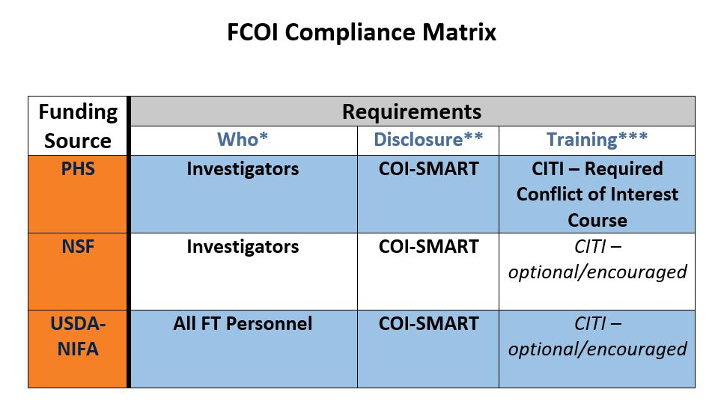
Conflict of Interest
The Matrix

Slide 17
COI training for ALL Employees
Optional but Encouraged
2 courses offered in FASTtrain
(eLearning) UC110e “Conflicts of Interest and Conflicts of Commitment
(classroom) UC100 “Conflicts of Interest”
Developed & presented by Division of Compliance and Privacy

Slide 18
Conflict of Interest
Questions about COI

Slide 19
Responsible Conduct of Research
What is it?

Slide 20
Responsible Conduct of Research
Definition
“The practice of scientific investigation with integrity. It involves the awareness and application of established professional norms and ethical principles in the performance of all activities related to scientific research.”– National Institutes of Health
Notes:
Poll 3 after this slide

Slide 21
Responsible Conduct of Research
Who requires RCR training?
NSF for UGs, Grads, & Post Docs
NIH for UGs, Grads, & Post Docs
USDA-NIFA UGs, Grads, Post Docs, & Faculty/Staff
All of the above
Notes:
Poll 4 after this slide

Slide 22
Responsible Conduct of Research
How and when to RCR train?
NSF CITI RCR in subject area at least every 5 years
NIH CITI & 8 hours face-to-face (instruction must occur during each career stage and at least once every four years)
USDA-NIFA CITI Biomedical Sciences course recommended (currently every 5 years)
All of the above
Note: NIH requirements & F2F RCR are in development’ training resources on web

Slide 23
Responsible Conduct of Research
The Matrix
Notes:
Breakout rooms here if there is time

Slide 24
COI/RCR Q & A
Q: Which federal sponsors require COI training?
A: Public Health Service Agencies and some non-PHS agencies.
Q: Name 2 PHS agencies. Name 2 Non-PHS agencies.

Slide 25
COI/RCR Q & A
Public Health Service (PHS) Agencies
Administration for Children and Families (ACF)
Administration for Community Living (ACL)
Agency for Healthcare Research and Quality (AHRQ)
Agency for Toxic Substances and Disease Registry (ATSDR)
Centers for Disease Control and Prevention (CDC)
Food and Drug Administration (FDA)
Health Resources and Services Administration (HRSA)
Indian Health Service (IHS)
National Institutes of Health (NIH)
Office of Global Affairs (OG)
Office of the Assistant Secretary for Health (OASH)
Office of the Assistant Secretary for Planning and Evaluation
Office of the Assistant Secretary for Preparedness and Response (ASPR)
Office of Public Health and Science
Substance Abuse and Mental Health Services Administration (SAMHSA)

Slide 26
COI/RCR Q & A
Non-PHS Agencies
Alliance for Lupus Research (ALR)
Alpha-1 Foundation
American Asthma Foundation
American Cancer Society (ACS)
American Heart Association (AHA)
American Lung Association (ALA)
Arthritis Foundation (AF)
CurePSP
Juvenile Diabetes Research Foundation (JDRF)
Lupus Foundation of America (LFA)
Patient-Centered Outcomes Research Institute (PCORI)
Susan G. Komen for the Cure
Varies. Check with individual sponsor to confirm.

Slide 27
COI/RCR Q & A
Q: When does the PHS require COI training to be complete?
A: Investigators must complete COI training prior to engaging in research related to any PHS-funded grant and at least every four years.
Q: Which federal sponsors require RCR training?
A: NSF – National Science Foundation
NIH – National Institutes of Health
USDA-NIFA – United States Dept. of Agriculture – National Institute of Food & Agriculture

Slide 28
COI/RCR Q & A
Q: Does USDA-NIFA require RCR training for everyone on a project?
A: Yes. By accepting a NIFA award the grantee assures that program directors, faculty, undergraduate students, graduate students, postdoctoral researchers, and any staff participating in the research project receive appropriate training and oversight in the responsible and ethical conduct of research and that documentation of such training will be maintained.

Slide 29
COI/RCR Q & A
Q: Who is the ‘Grantee’?
A: The University
Q: Who is required to take NSF RCR training?
A: Each institution that applies for financial assistance from the Foundation for science and engineering research or education must describe in its grant proposal a plan to provide appropriate training and oversight in the responsible and ethical conduct of research to undergraduate students, graduate students, and postdoctoral researchers participating in the proposed research project.

Slide 30
COI/RCR Q & A
Q: Who is required to take NIH RCR training?
A: NIH requires that all trainees, fellows, participants, and scholars receiving support through any NIH training, career development award (individual or institutional), research education grant, and dissertation research grant must receive instruction in responsible conduct of research. This policy will take effect with all new and renewal applications submitted on or after January 25, 2010, and for all continuation (Type 5) applications with deadlines on or after January 1, 2011. This Notice applies to the following programs: D43, D71, F05, F30, F31, F32, F33, F34, F37, F38, K01, K02, K05, K07, K08, K12, K18, K22, K23, K24, K25, K26, K30, K99/R00, KL1, KL2, R25, R36, T15, T32, T34, T35, T36, T37, T90/R90, TL1, TU2, and U2R. This policy also applies to any other NIH-funded programs supporting research training, career development, or research education that require instruction in responsible conduct of research as stated in the relevant funding opportunity announcements.

Slide 31
COI/RCR Q & A
Q: As of October 2, 2019, how is COI Disclosure regulated at Auburn University?
A: All fulltime employees must disclose annually and update their disclosure within 30 days of discovering/acquiring a new SFI.
PHS/NSF Investigators who are not FTEs must disclose prior to engaging in PHS/NSF related research and update their disclosure annually during the award term and within 30 days of discovering/acquiring a new SFI.
https://auburn.coi-smart.com

Slide 32
COI/RCR Q & A
Q: What about sub-recipients?
A: When AU is the Prime, sub-recipients must complete the Sub-recipient Commitment Form which includes COI certifications sections for PHS and NSF.
When AU is the Sub, can follow AU policy & procedures if they are compliant with Federal Awarding Agency.
When AU is the Sub, Prime can require additional compliance measures. Example: For certain NASA funded projects where UAH is the Prime and AU is the Sub there is an RCR training requirement that AU Investigators must complete.

Slide 33
COI/RCR Q & A
Q: COI Management Plans – Fact or Myth?
A COI is BAD!
MYTH
Many COIs can be managed
FACT
A COI management plan will negatively affect my career
MYTH
A COI management plan can allow me to compliantly continue my career and other interests
FACT
A COI management plan can protect an individual and the university
FACT

Slide 34
Questions?
Would you or your investigators find virtual office hours helpful?
How can Research Compliance HELP you?
Resources
ORC Webpage - https://cws.auburn.edu/ovpr/pm/compliance/home
Research Resource Hub - aub.ie/FacultyResearchResourceHub

