Slide 1
Time and Effort
Fall 2016

Slide 2
Time and Effort
What is Effort?
Effort is defined as the amount of time spent on a particular activity. It includes the time spent working on a sponsored project in which salary is directly charged or contributed (cost-share effort).
Individual effort is expressed as a percentage of the total amount of time spent on work-related activities (instruction, research, administration, etc.) for which the University compensates an individual.

Slide 3
Time and Effort
How many hours per week is
100% FTE for faculty?

Slide 4
Time and Effort
To determine effort as a percentage of time, divide the hours worked by the total effort hours.

Slide 5
Time and Effort
Dr. John Smith received the NSF award for which he applied. If Dr. Smith worked 40 hours on a sponsored project in a given time period and 25 hours in the same given time period on an unrelated University project, then how much effort did Dr. Smith apply toward the NSF project? How much effort toward other University activities?
Solution:
40 hours / 65 total-effort hours = 61.5%
And
25 hours / 65 total-effort hours = 38.5%

Slide 6
Time and Effort
Proposals should reasonably represent the amount of time that key personnel are committing to the project.
Effort should be proposed as anticipated by the project scope.

Slide 7
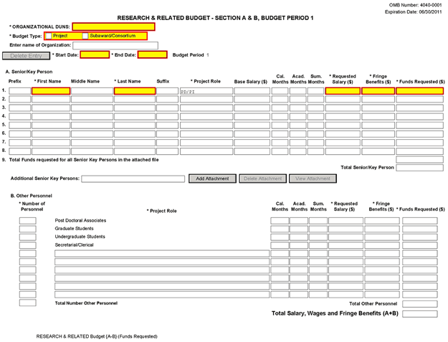
Time and Effort

Slide 8
Time and Effort
To determine the number of months of effort multiply the number of months by the percent of effort.

Slide 9
Time and Effort
How many months effort is 10% effort over 12 calendar months?
10% X 12 months = 1.2 months effort
How many months effort is 10% effort over 9 academic months?
10% X 9 months = 0.9 months effort
How many months efforts is 75% effort over 3 summer months?
75% X 3 months = 2.25 months effort

Slide 10
Time and Effort
Considerations for Graduate Students:
Federal regulations limit graduate assistantships for international graduate students to no more than a 0.5 FTE (20 hours per week) work appointment during the fall and spring semesters.
[See Office of International Programs for full details.]
Assistantship and Tuition Fellowship Program Policy
http://www.grad.auburn.edu/ps/presgradfellows.html
Graduate assistant appointments must add up to a .25 FTE, .33 FTE, or .50 FTE. Assistantships of .33 FTE or .50 FTE are required for full tuition support. Assistantships of .25 FTE provide for ½ tuition support.

Slide 11
Time and Effort
Percent of Time & Effort to Person Months calculator
http://grants.nih.gov/grants/policy/person_months_faqs.htm

Slide 12
Time and Effort
Questions?

